Slide 1
W03D1 – Data Visualization
Instructor: Jeremy Eng
Credit: Eric Elmoznino
Adapted from: Fundamentals of Data Visualization

Slide 2

Introduction
Instructor: Dr. Jeremy Eng (engj@saskpolytech.ca)
Lead Cloud Applications and Data Instructor at Sask Polytech
Born and raised in Saskatoon, Saskatchewan
PhD in Statistics
Research Areas:
Big data simulations involving Monte Carlo techniques
Developing and applying machine learning techniques to model COVID-19 spread in Saskatchewan and Canada (PMCMC)
Microsoft Certified Trainer
LinkedIn: https://www.linkedin.com/in/jeremy-eng-sk/

Slide 3
Outline
Motivation
Why visualize data?
What can go wrong?
Types of Visuals
Visualizing: amounts, distributions, proportions, relationships, and geospatial data
Jigsaw activity
Design Principles
Proportional ink
Using colours
Using encodings
Label clearly

Slide 4
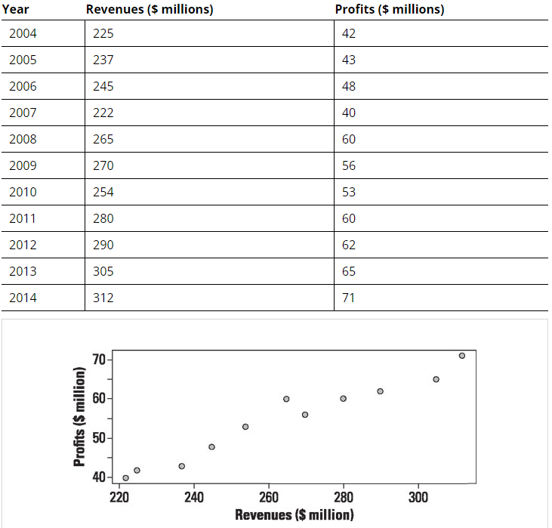
Motivation: Why Visualize Data?
Humans have evolved with excellent vision
Size and proportion
Space and spatial relationships
Colour
Motion/animation
Humans have not evolved to read numbers or tables
Common data visualization usages:
Summarize data and results
Identify patterns or trends.
Compare and contrast data
Identify outliers.

Slide 5
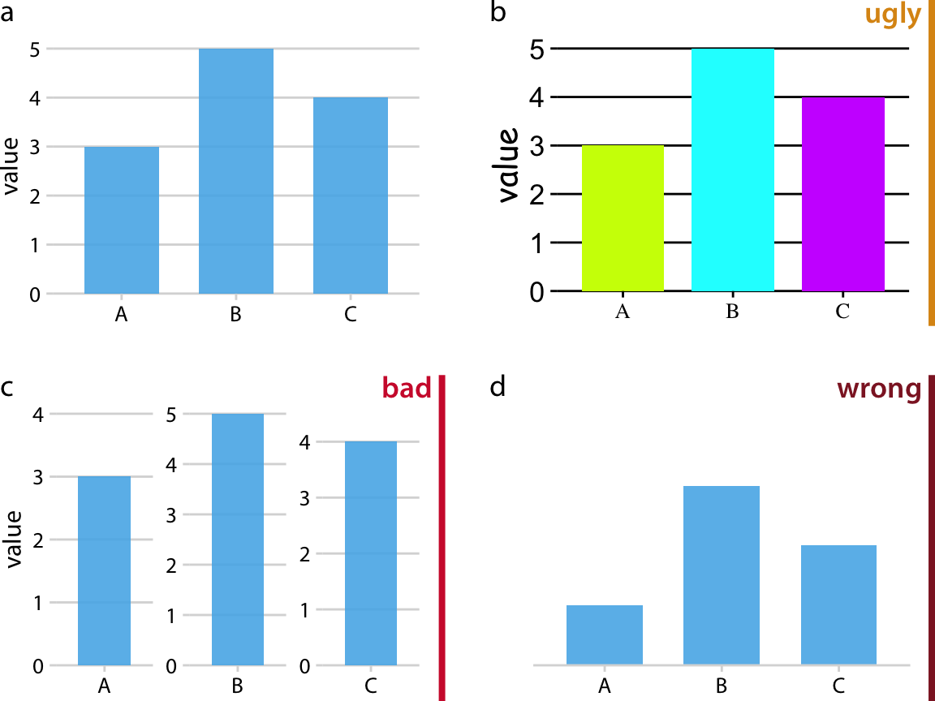
Motivation: What Can Go Wrong?
ugly: A figure that has aesthetic problems but otherwise is clear and informative.
bad: A figure that has problems related to perception; it may be unclear, confusing, overly complicated, or deceiving.
wrong: A figure that has problems related to mathematics; it is objectively incorrect.

Slide 6
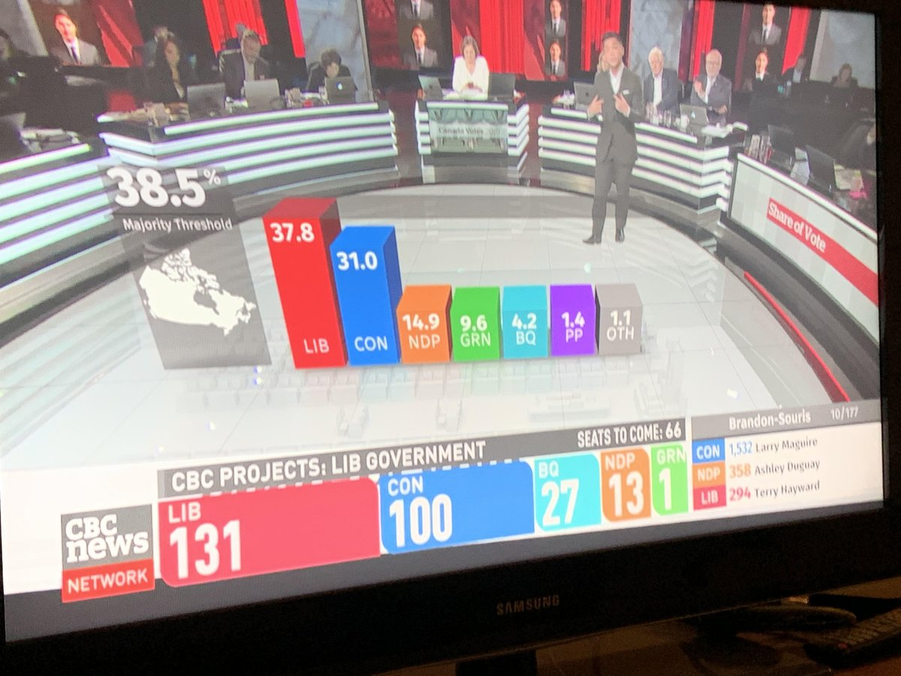
Motivation: What Can Go Wrong?
Notes:
Visuals should accurately reflect the data

Slide 7
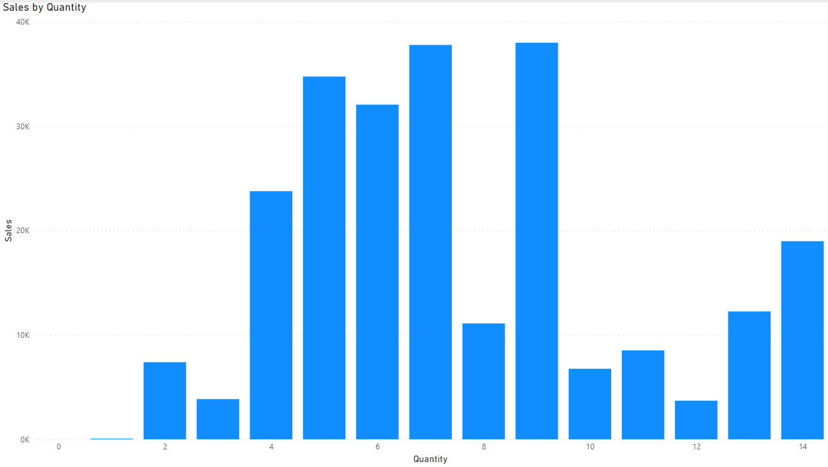
Types of Visualizations
Visualizing amounts: bar plots, grouped/stacked bars, dot plots, heatmaps
Visualizing distributions: histograms, density plots, boxplots
Visualizing proportions: bars, mosaic plots, tree maps
Visualizing x-y relationships: scatterplot, bubble chart
Visualizing geospatial data: choropleth, cartogram
Multi-panel figures
Many more

Slide 8
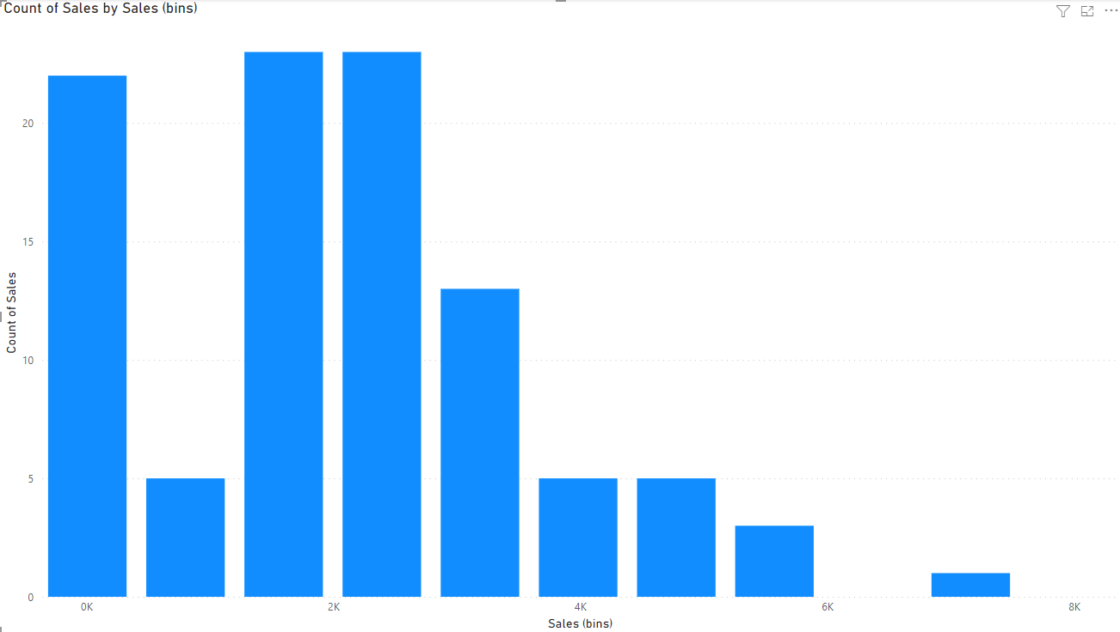
Types of Visualizations
Visualizing amounts: bar plots, grouped/stacked bars, dot plots, heatmaps
Visualizing distributions: histograms, density plots, boxplots
Visualizing proportions: bars, mosaic plots, tree maps
Visualizing x-y relationships: scatterplot, bubble chart
Visualizing geospatial data: choropleth, cartogram
Multi-panel figures
Many more

Slide 9
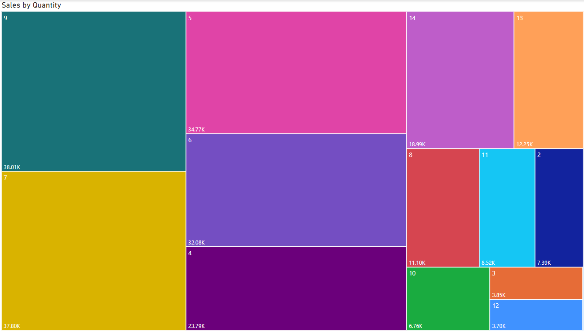
Types of Visualizations
Visualizing amounts: bar plots, grouped/stacked bars, dot plots, heatmaps
Visualizing distributions: histograms, density plots, boxplots
Visualizing proportions: pie chart, mosaic plots, tree maps
Visualizing x-y relationships: scatterplot, bubble chart
Visualizing geospatial data: choropleth, cartogram
Multi-panel figures
Many more

Slide 10
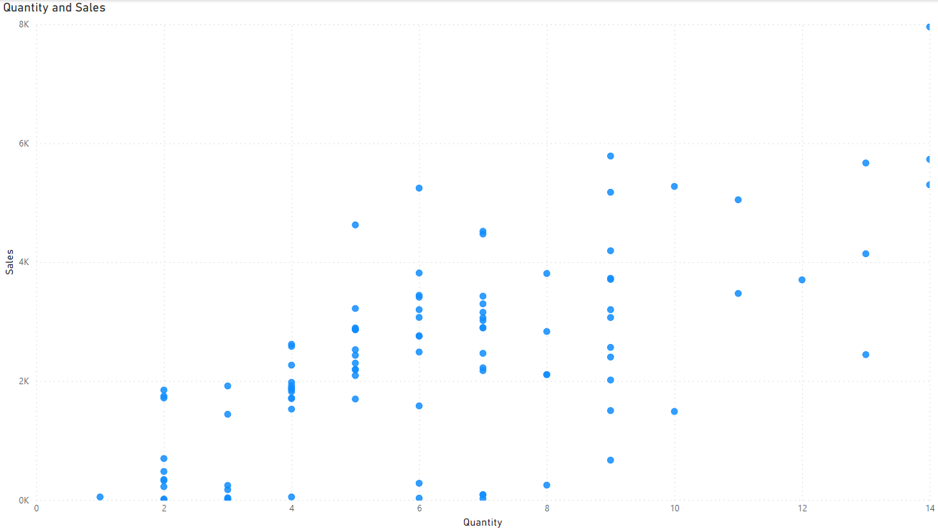
Types of Visualizations
Visualizing amounts: bar plots, grouped/stacked bars, dot plots, heatmaps
Visualizing distributions: histograms, density plots, boxplots
Visualizing proportions: pie chart, mosaic plots, tree maps
Visualizing x-y relationships: scatterplot, bubble chart
Visualizing geospatial data: choropleth, cartogram
Multi-panel figures
Many more

Slide 11
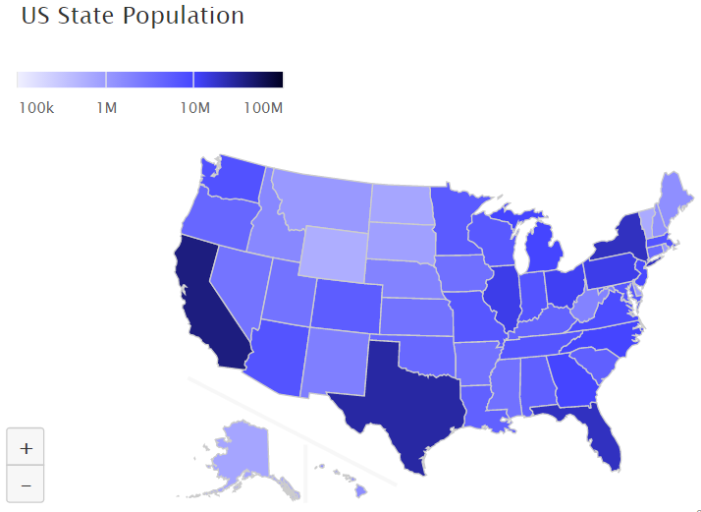
Types of Visualizations
Visualizing amounts: bar plots, grouped/stacked bars, dot plots, heatmaps
Visualizing distributions: histograms, density plots, boxplots
Visualizing proportions: pie chart, mosaic plots, tree maps
Visualizing x-y relationships: scatterplot, bubble chart
Visualizing geospatial data: choropleth, cartogram
Multi-panel figures
Many more

Slide 12
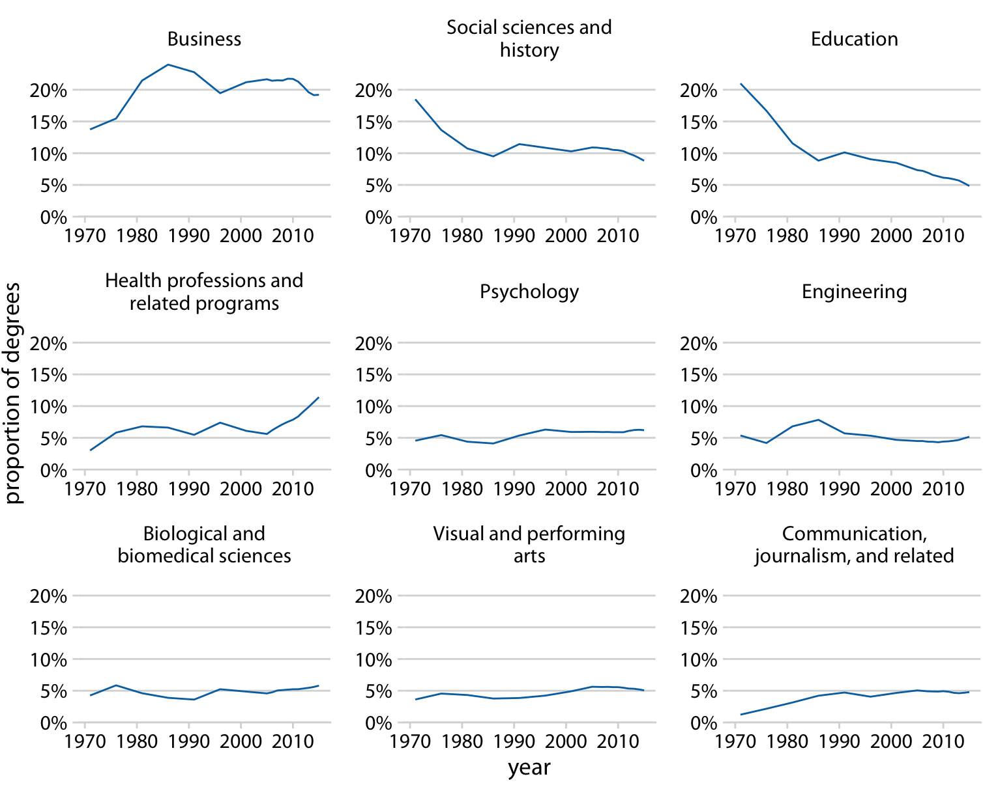
Types of Visualizations
Visualizing amounts: bar plots, grouped/stacked bars, dot plots, heatmaps
Visualizing distributions: histograms, density plots, boxplots
Visualizing proportions: pie chart, mosaic plots, tree maps
Visualizing x-y relationships: scatterplot, bubble chart
Visualizing geospatial data: choropleth, cartogram
Multi-panel figures
Many more
Notes:
All very fluid. The same types of charts can be used for different purposes depending on what you’re trying to show. For instance, scatterplots can be used for almost any of these goals.
Plotting libraries we use will have support for many of these standard plot types. Documentation/examples to see how they’re used, don’t just guess!

Slide 13
Types of Visualizations: Activity—Jigsaw (10 min)
Each person will be assigned a graph/chart.
Your job is to share with the class:
Give a quick explanation and example use-case
Why is it useful? (amounts, distributions, proportions, relationships, geospatial)
What would be on the x and y axes (if applicable)?
What other encodings (color, size) can be used?
Can they be made in Python? Find some code samples (if you have time)
Present (don’t prep slides, just walk through it while on a website)
Directory of Visualizations: https://clauswilke.com/dataviz/directory-of-visualizations.html
Don’t be afraid to Google the chart types to understand them better!
Notes:
Types of visuals:
Scatter plot (dot plot)
Heat map
Histogram
Box plot
Choropleth
Tree map
Violin plot
Density contours
Cartogram
Pie chart
Mosaic plot
Sina plot
Bar chart

Slide 14
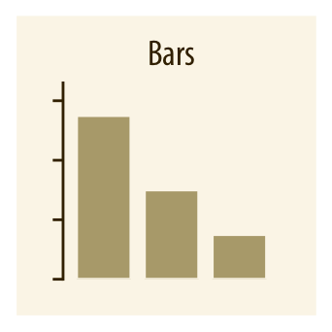
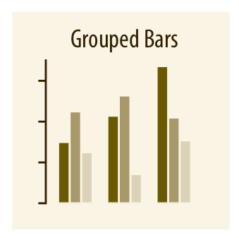
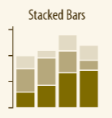
Types of Visualizations: Activity—Example
Sales by continent
Sales by business unit by continent
x-axis: continent
y-axis: sales in USD
color: grouping of continents
x-axis (group): continent
y-axis: sales in USD
color: business unit (clothing, accessories, etc.)
Notes:
Your job is to share with the class:
Give a quick explanation and example use-case
Why is it useful? (amounts, distributions, proportions, relationships, geospatial)
What would be on the x and y axes (if applicable)?
What other encodings (color, size) can be used?
Can they be made in Python? Find some code samples (if you have time)
Question: How do you pick whether to within-group elements be different business units or different continents? What factors go into the decision?

Slide 15
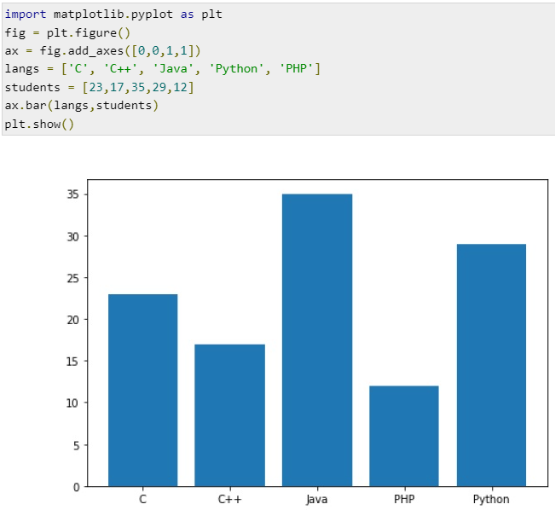
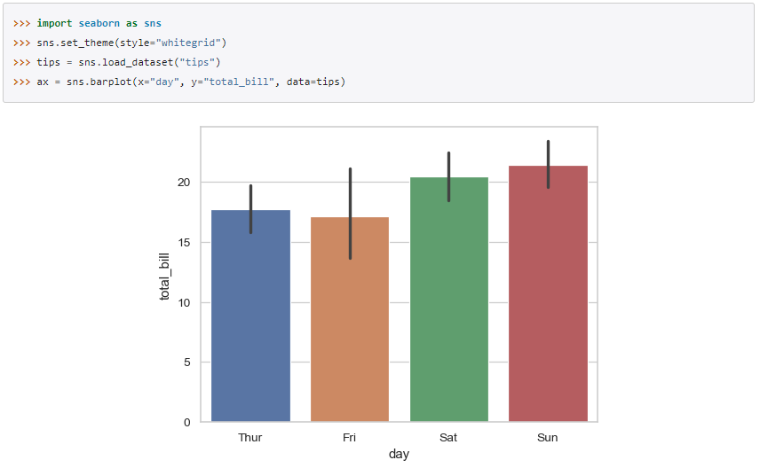
Types of Visualizations: Activity—Example
Notes:
Your job is to share with the class:
Give a quick explanation and example use-case
Why is it useful? (amounts, distributions, proportions, relationships, geospatial)
What would be on the x and y axes (if applicable)?
What other encodings (color, size) can be used?
Can they be made in Python? Find some code samples (if you have time)
Question: How do you pick whether to within-group elements be different business units or different continents? What factors go into the decision?

Slide 16
Design Principles
Principle of proportional ink
Picking colours that have meaning
Use encodings to your advantage
Label clearly

Slide 17
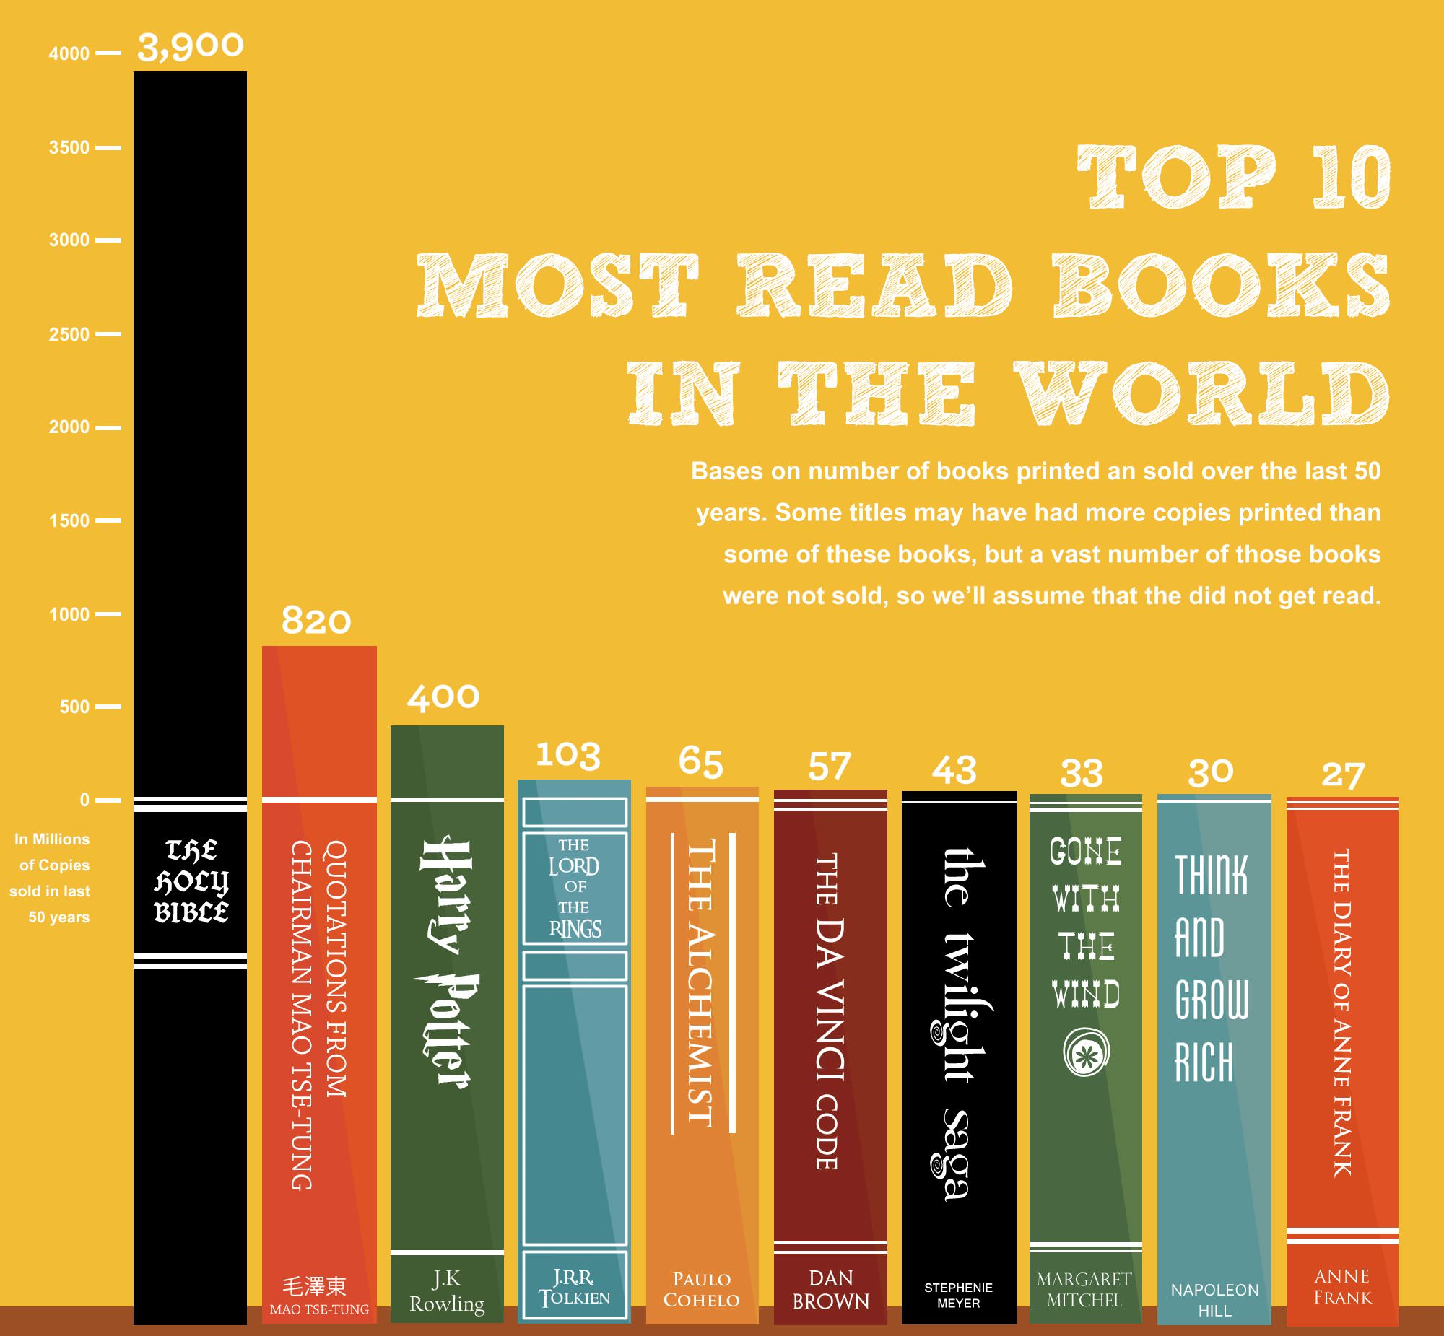
The Principle of Proportional Ink
The principle of proportional ink: The sizes of shaded areas in a visualization need to be proportional to the data values they represent.

Slide 18
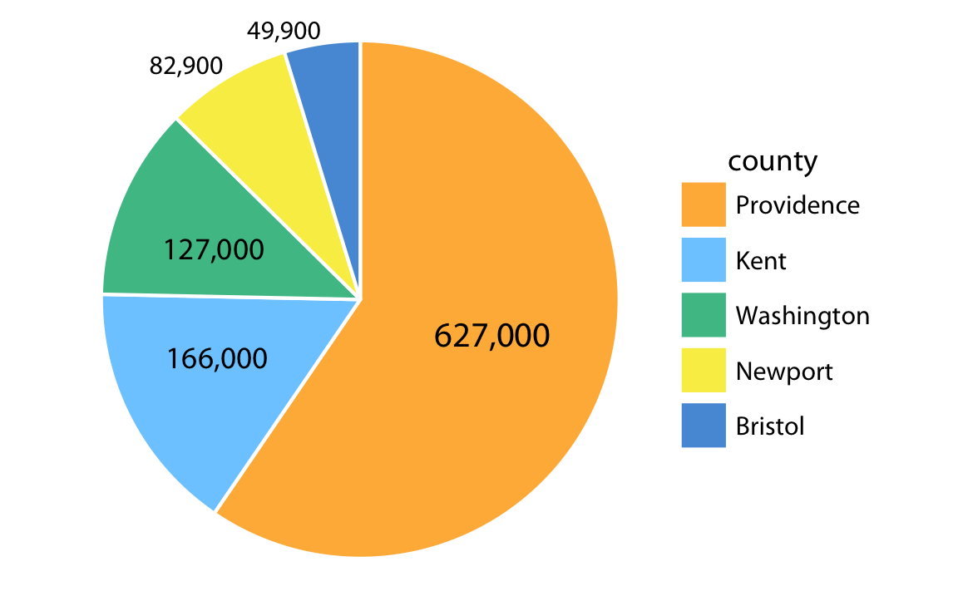
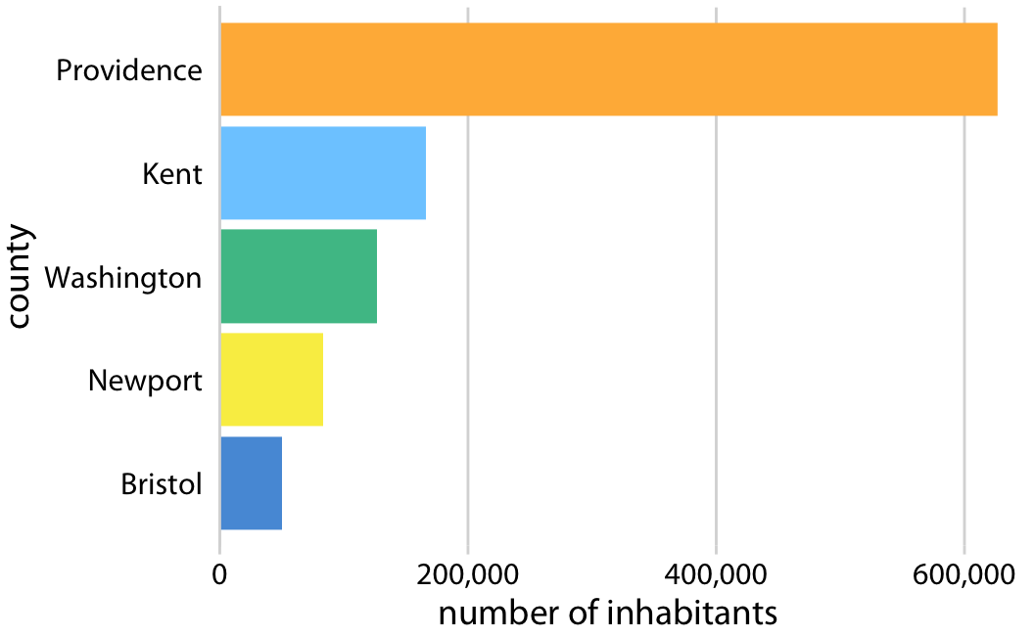
The Principle of Proportional Ink

Slide 19
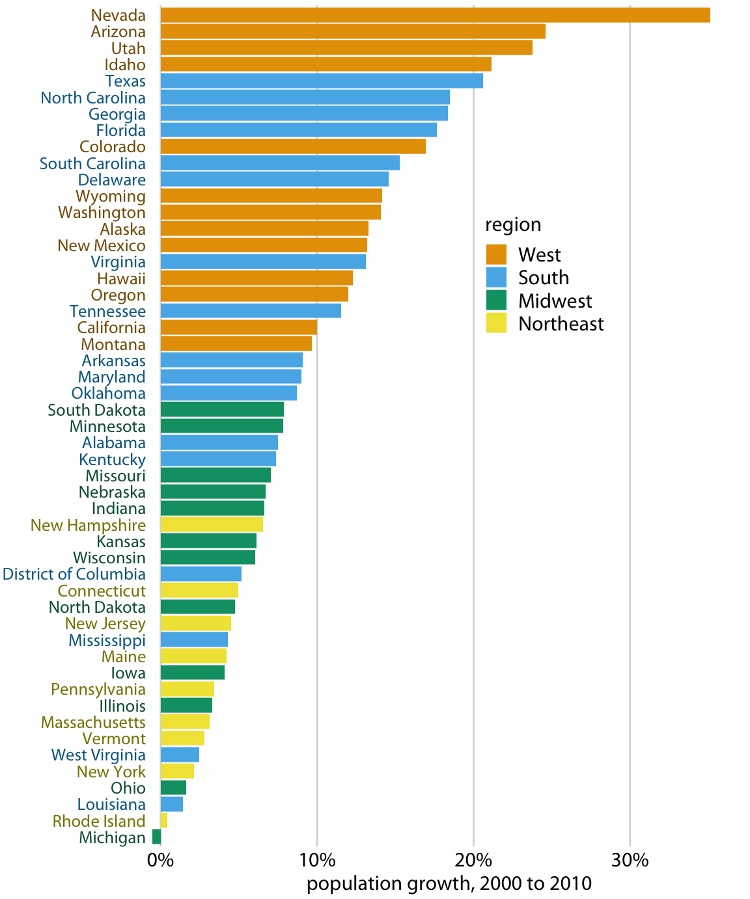
Using Colour
Components of colour:
Hue (orange, blue, green, etc.)
Saturation (intensity)
Can use colour (hue) to represent discrete items or groups that don't have an intrinsic order.
Can use color (saturation) to represent data values on a sequential scale.
Can use color (hue and saturation) to represent data values on a divergent scale.
Can use color (hue) to highlight a particular group.

Slide 20
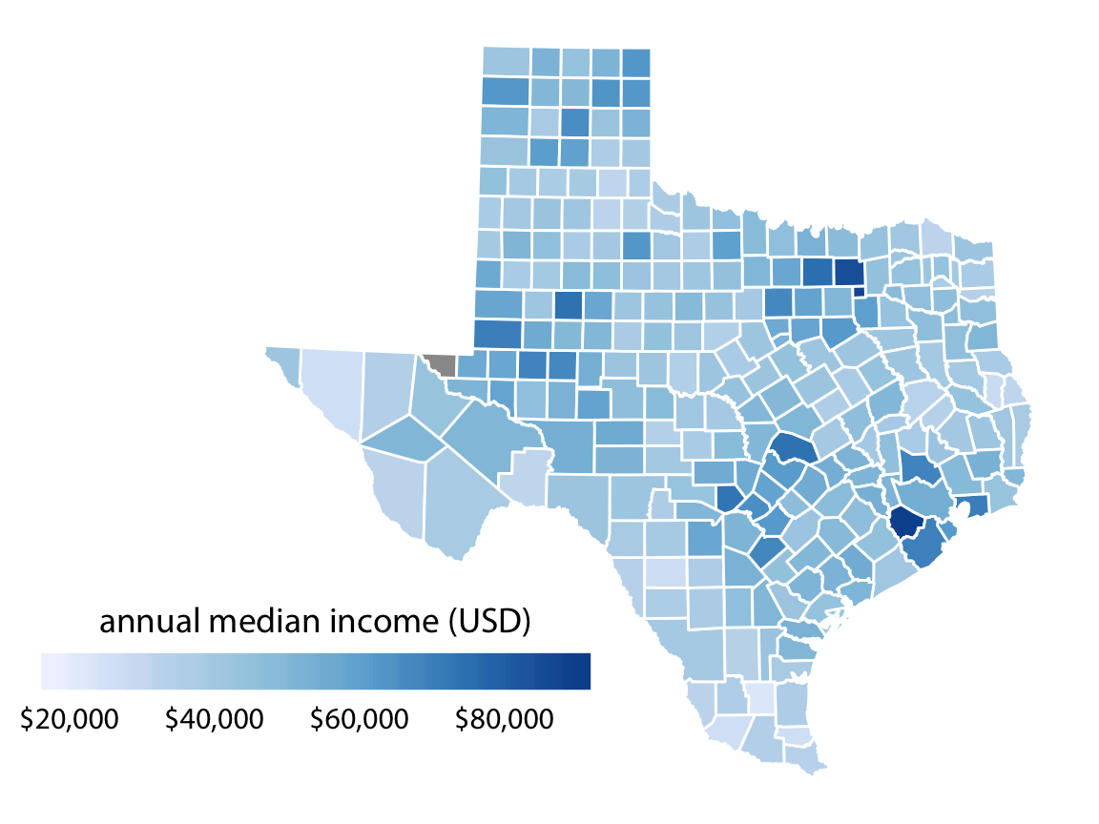
Using Colour
Components of colour:
Hue (orange, blue, green, etc.)
Saturation (intensity)
Can use colour (hue) to represent discrete items or groups that don't have an intrinsic order.
Can use color (saturation) to represent data values on a sequential scale.
Can use color (hue and saturation) to represent data values on a divergent scale.
Can use color (hue) to highlight a particular group.

Slide 21
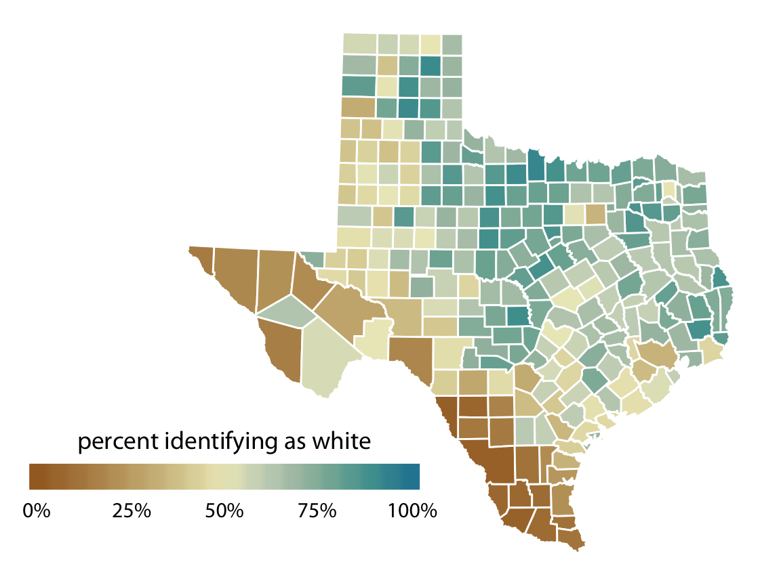
Using Colour
Components of colour:
Hue (orange, blue, green, etc.)
Saturation (intensity)
Can use colour (hue) to represent discrete items or groups that don't have an intrinsic order.
Can use color (saturation) to represent data values on a sequential scale.
Can use color (hue and saturation) to represent data values on a divergent scale.
Can use color (hue) to highlight a particular group.

Slide 22
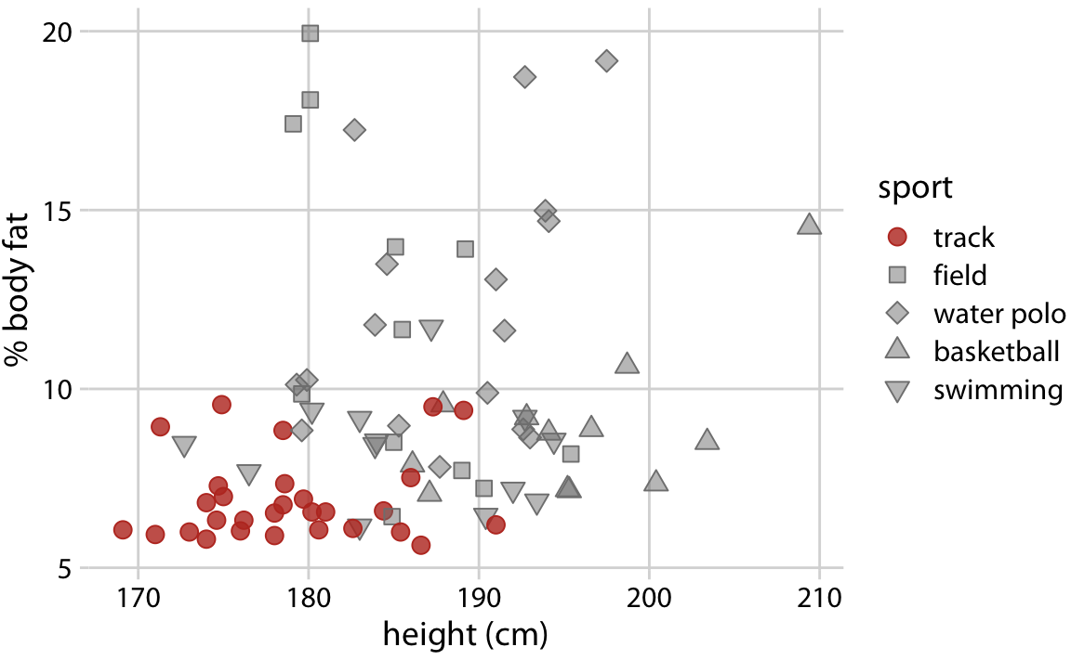
Using Colour
Components of colour:
Hue (orange, blue, green, etc.)
Saturation (intensity)
Can use colour (hue) to represent discrete items or groups that don't have an intrinsic order.
Can use color (saturation) to represent data values on a sequential scale.
Can use color (hue and saturation) to represent data values on a divergent scale.
Can use color (hue) to highlight a particular group.

Slide 23
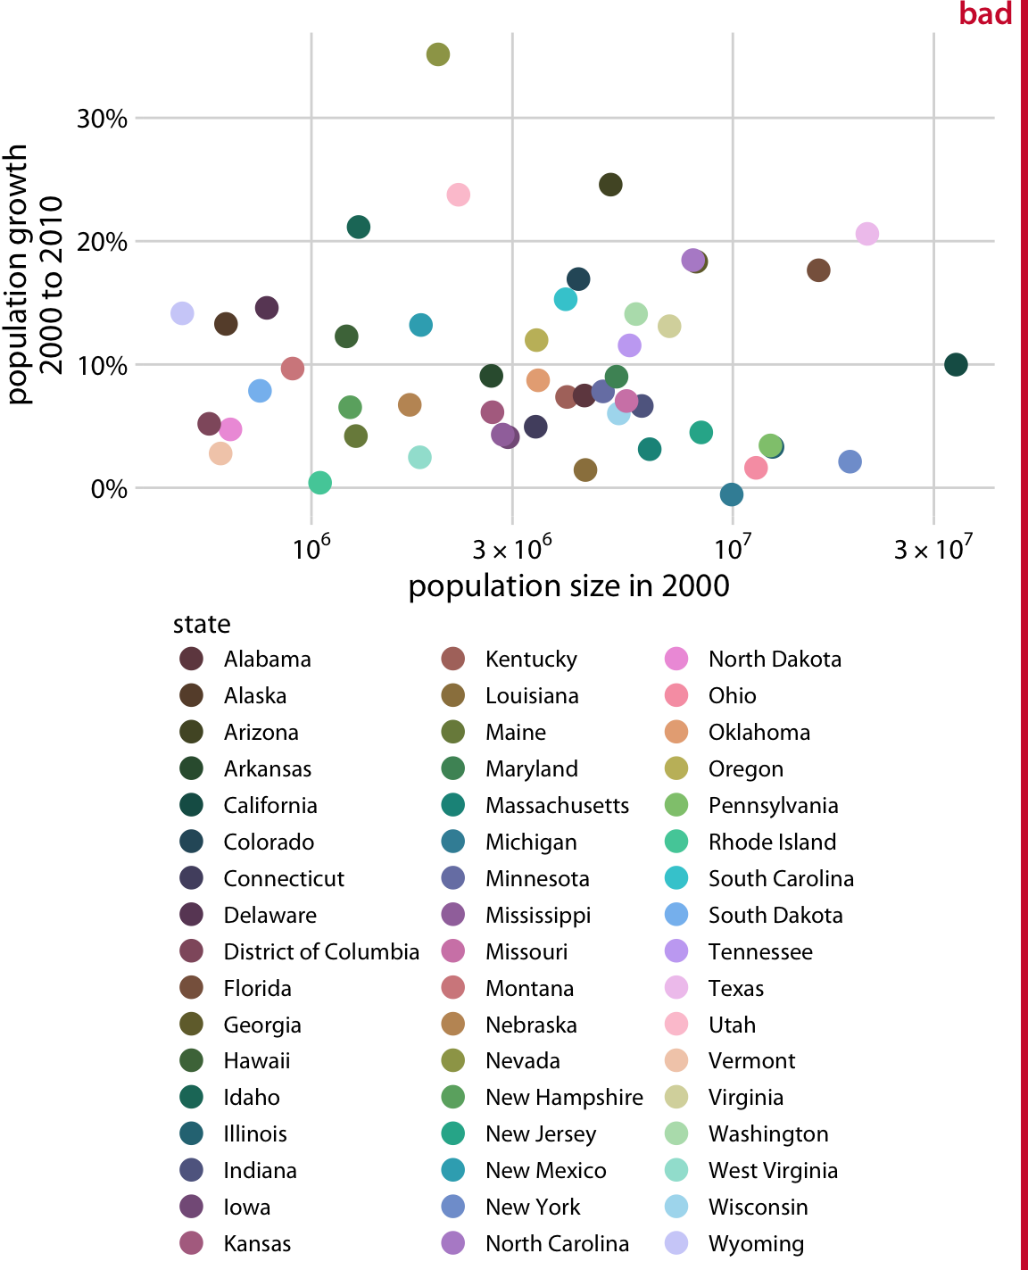
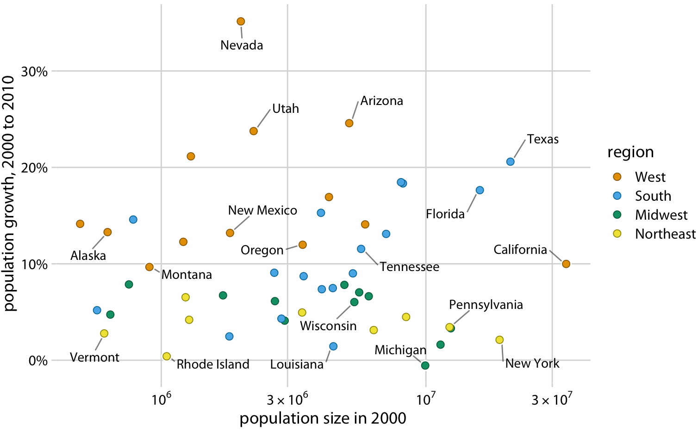
Using Colour
Notes:
Colour should contribute information (or clarity) to the visual

Slide 24
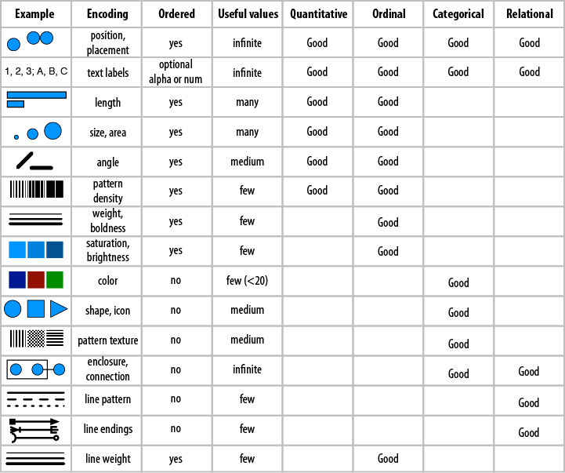
Using Encodings
Notes:
Pick the right encoding for your purpose

Slide 25
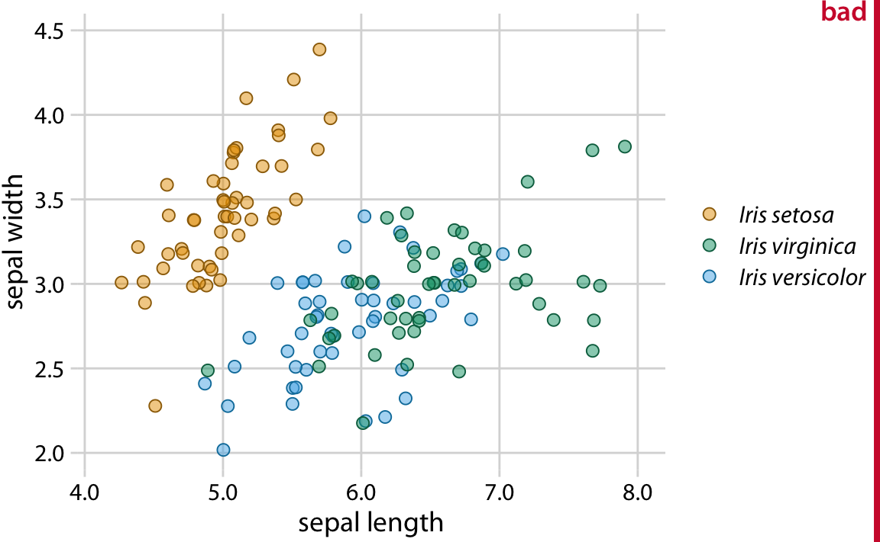
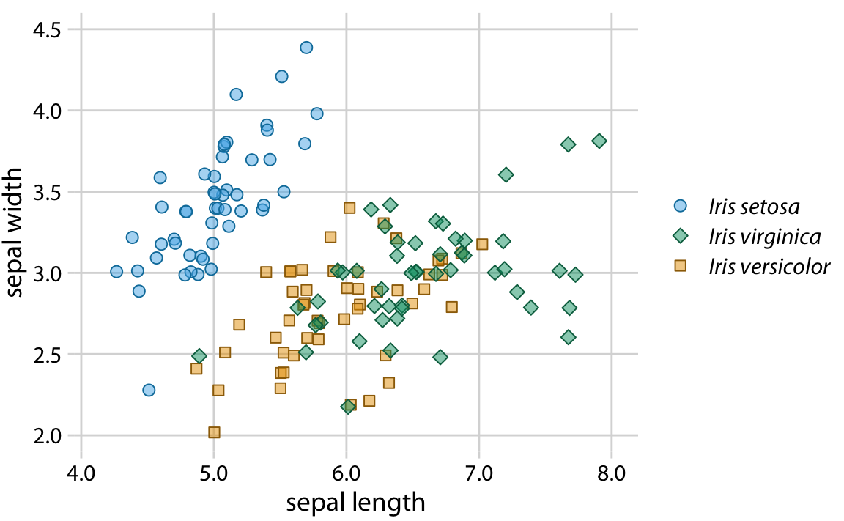
Using Encodings
Notes:
Ensure similar colours are separated spatially
Redundant coding (can implement multiple encodings representing the same thing)
Clutter
Color-vision deficiency
Grayscale (printing)

Slide 26
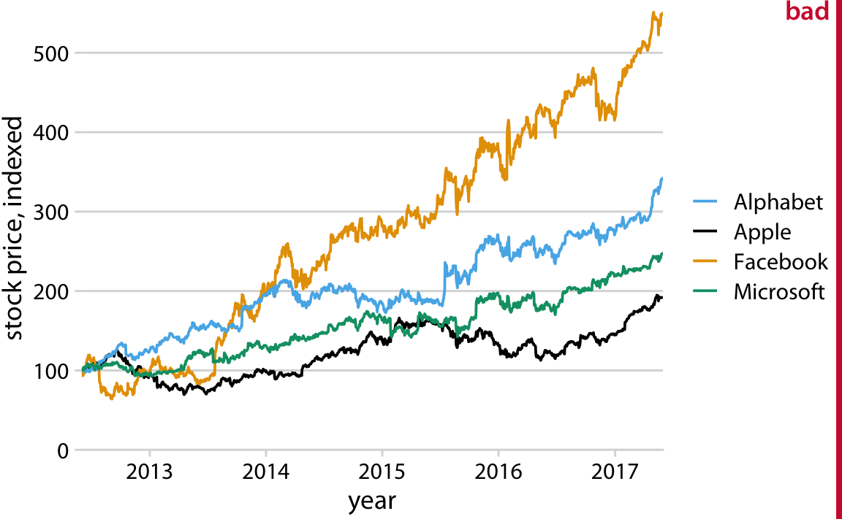
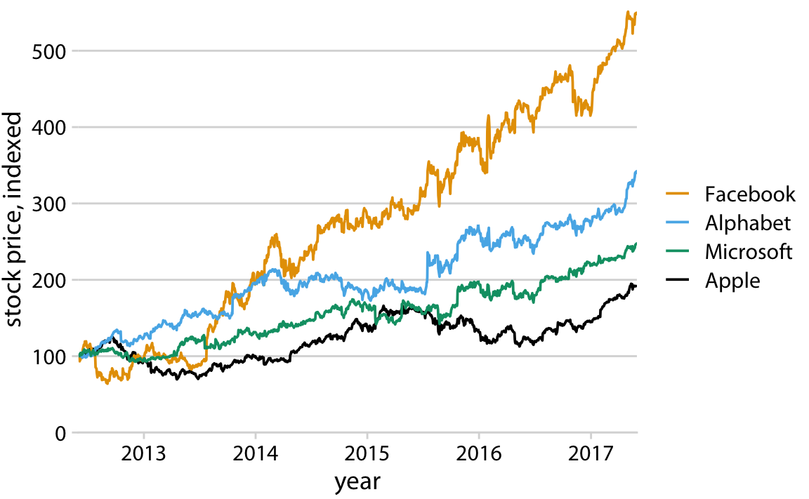
Using Encodings
Notes:
Ordering in the legend

Slide 27
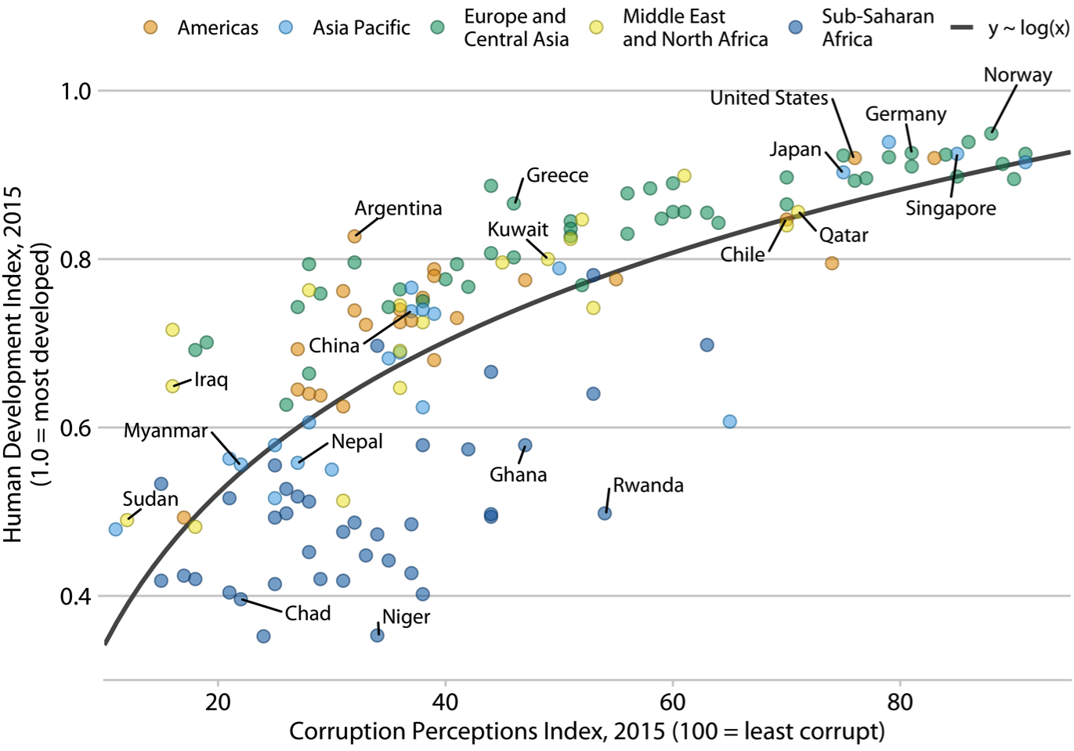
Label Clearly
Notes:
Quick, what is this graph demonstrating?

Slide 28
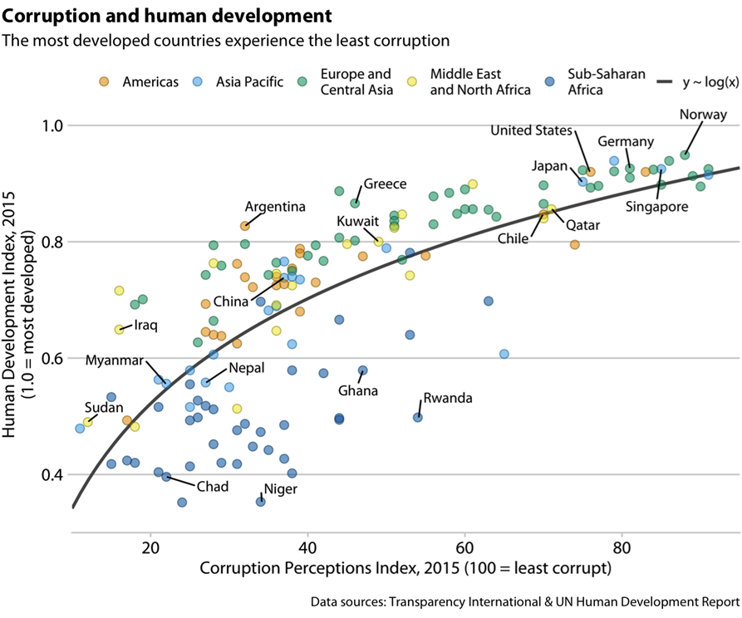
Label Clearly
Notes:
A simple title can help interpretation
Anything else you’d change about this plot?

Slide 29
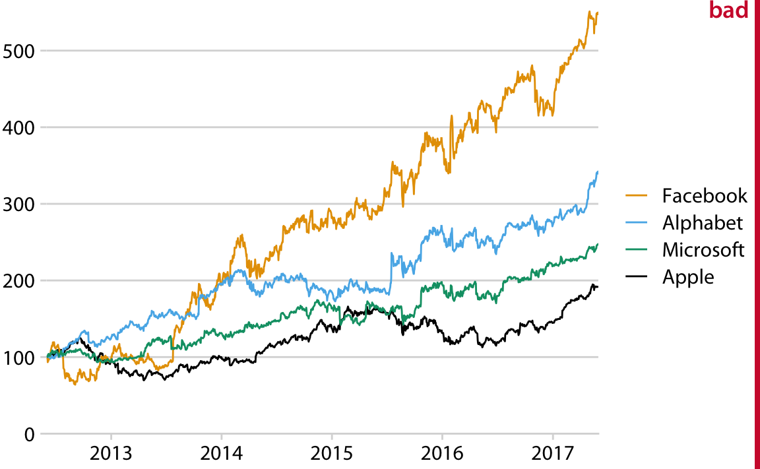
Label Clearly
Notes:
What is wrong with this plot?
Missing y-axis label

Slide 30
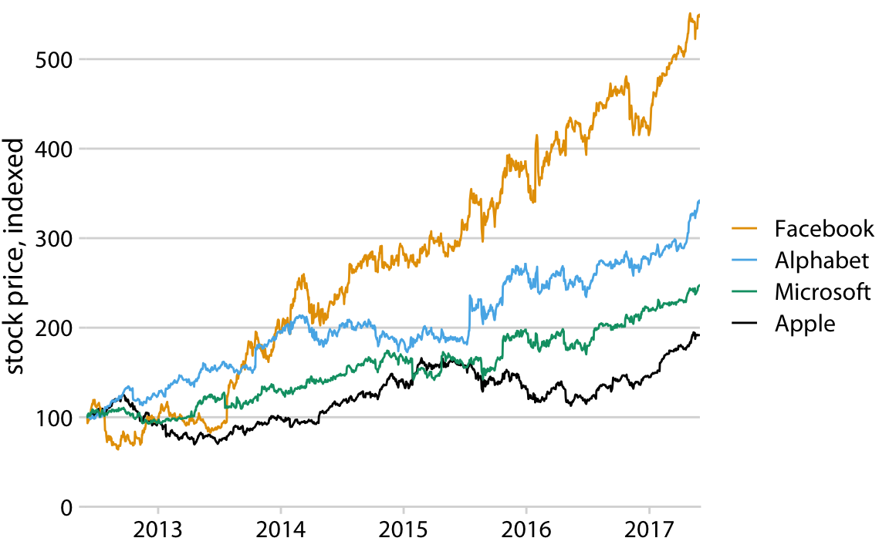
Label Clearly

Slide 31
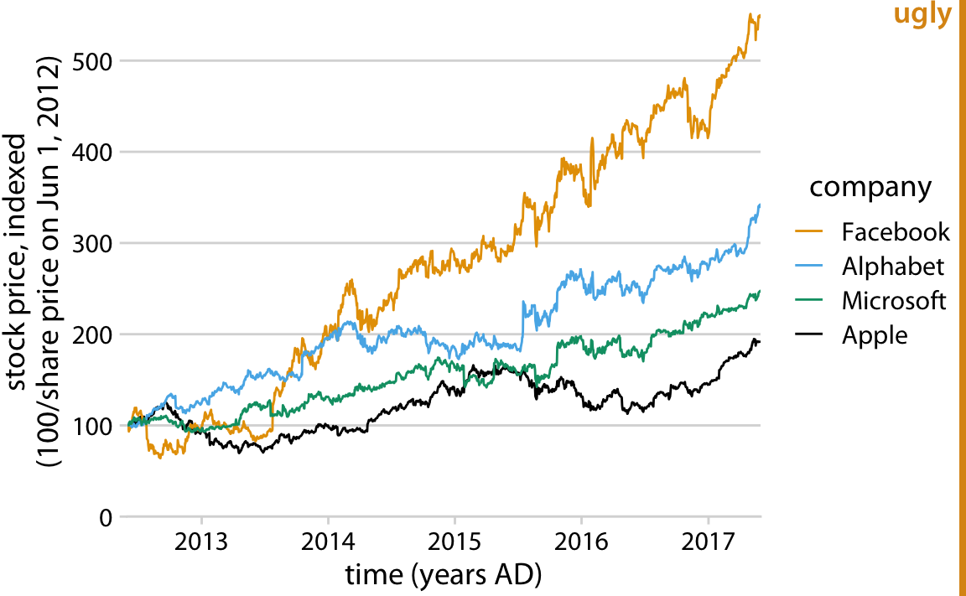
Label Clearly
Notes:
Can also potentially have too much info in axes

Slide 32
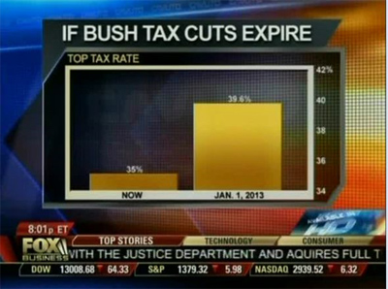
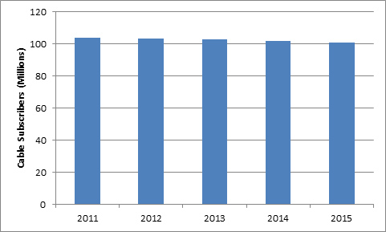
Label Clearly
Notes:
To include zero or not?

Slide 33
Additional Resources
Fundamentals of Data Visualization (Wilke): https://clauswilke.com/dataviz/index.html
A guide for what visualizations to use based on the data format: https://www.data-to-viz.com/
Matplotlib: https://matplotlib.org/
Seaborn: https://seaborn.pydata.org/
Plotly: https://plotly.com/
Data Visualization Demo

